Slide 1

WIMAX
Hazırlayan:
19011502 - Gülsüm İrem Baş
20011021 - Furkan Salman
20011028 - Onur Eray Bölük
20011029 - Alperen Oğuz Demir
20011619 - Onat Duman

Slide 2
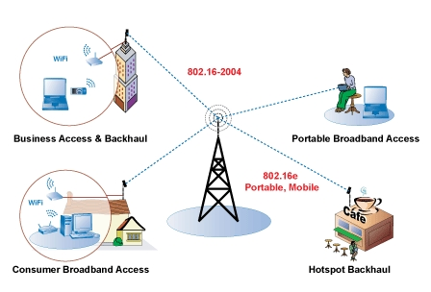
WIMAX OVERVIEW
What is WiMAX:
WIMAX(Worldwide Interoperability for Microwave Access) is a telecommunications standard that provides wireless high-speed internet and other digital communications services over a wide area. It is a type of wireless broadband technology that uses microwaves to transmit data over long distances.

Slide 3
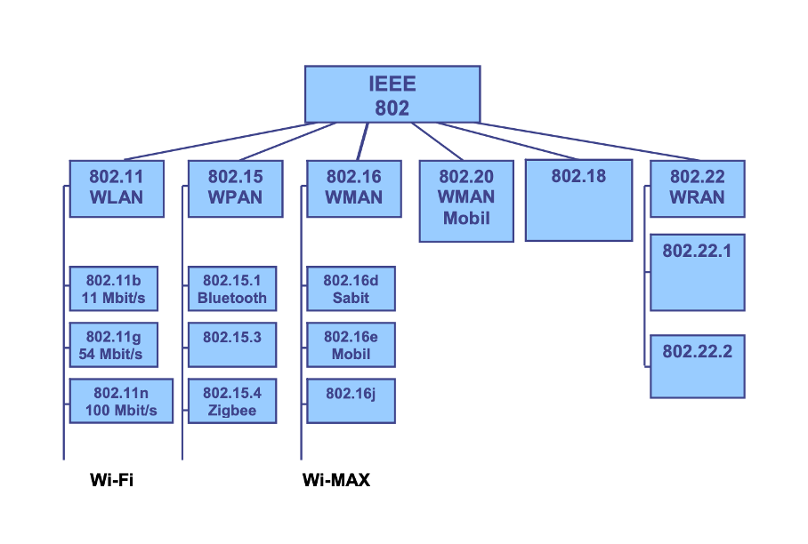
WIMAX OVERVIEW
Purpose of WIMAX:
The main purpose of WIMAX is to provide high-speed wireless internet access to a wide area. It is particularly useful in areas where treditional broadband infrastructure , such as cable or DSL, is not available or is not sufficient to meet the demand for high-speed internet access.
Some features:
High data rates
LOS/NLOS
Wide coverage area

Slide 4
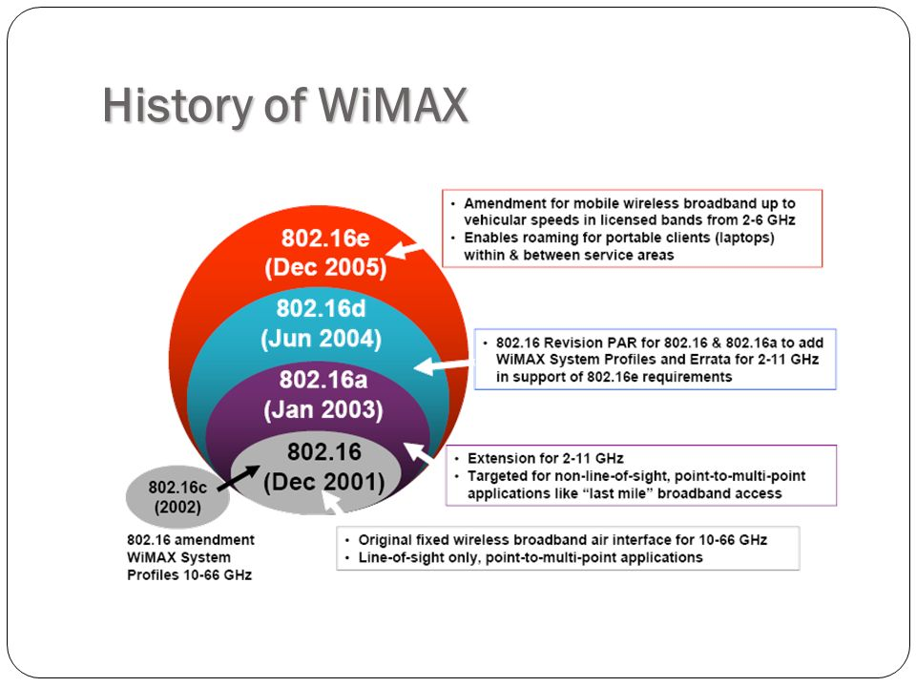
WIMAX OVERVIEW
History of WIMAX:
End of 1990s
2001- 802.16
2003-802.16a
802.16d- 802.16e
2005

Slide 5
Versions
WiMAX Version | Release Dates | Data Rates | Key Features
WiMAX 1.0 (IEEE 802.16) | 2001 | Up to 138 Mbps | Initial release, Line Of Sight
WiMAX 1.0 (IEEE 802.16a) | 2004 | Up to 75 Mbps | Non-Line of Sight support
WiMAX 1.5 (IEEE 802.16e) | 2005 | Up to 75 Mbps | Mobility support
WiMAX 2.0 (IEEE 802.16m) | 2009 | Up to 100 Mbps | MIMO support
WiMAX 2.1 (IEEE 802.16m) | 2011 | Up to 100 Mbps | Carrier aggregation, HD video support, improved MIMO support
WiMAX 2.5 (IEEE 802.16m) | 2014 | Up to 100 Mbps | Higher frequency bands, advanced modulation, improved MIMO support
WiMAX 3.0 (IEEE 802.16s) | 2020 | Up to 100 Mbps | Very high frequency bands, advanced MIMO, improved carrier aggregation

Slide 6
Features
High Speed : Wimax can provide broadband speeds of up to 75 Mbps for stationary devices and up to 20Mbps for mobile devices, making it suitable for a wide range of applications: high-definition video streaming, voice over IP (VoIP) and online gaming.
Long Range : Wimax can cover distances of up to 50 KM in NLOS to 10 KM LOS which makes it suitable for both rural and urban areas.
Frequency Bands : Wimax operates various frequency bands including 2.3 GHz , 2.5 GHz and 3.5 GHz.
Multiple Access Methods : Wimax supports both TDMA (Time-Division Multiplexing Access) and OFDMA (Orthogonal Frequency-Division Multiplexing Access).

Slide 7
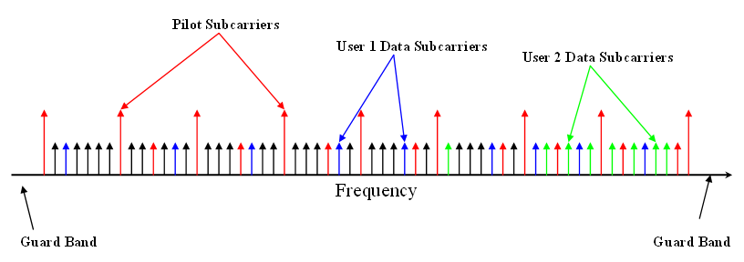
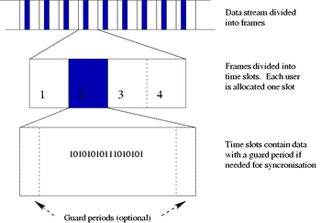
Features
OFDMA
TDMA

Slide 8
Features
Security : Wimax supports various security protocols such as AES (Advanced Encryption Standard) and TKIP (Temporal Key Integrity Protocol).
Quality of Service (QoS) : Wimax supports QoS mechanisms such as prioritization of different types of traffic and resource allocation to ensure that critical applications such as voice and video receive adequate bandwidth.
Interoperability : Wimax is an international standard and is interoperable with other wireless communication technologies such as 3G and 4G cellular networks, allowing for seamless integration with existing infrastructure

Slide 9
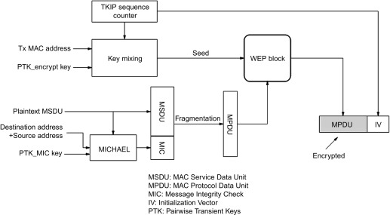
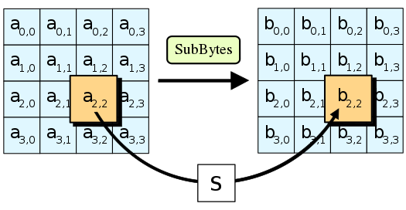
Features
AES
TKIP

Slide 10
Comparison
WiMAX and LTE:
The two technologies, WiMAX and LTE, competed with each other starting their pre-4G versions and continued with their 4G versions while having much in common. It looks like that finally WiMAX gave up the competition and selected to harmonize and integrate with LTE in its future harmonized WiMAX advanced standard supporting multiple access technologies.

Slide 11
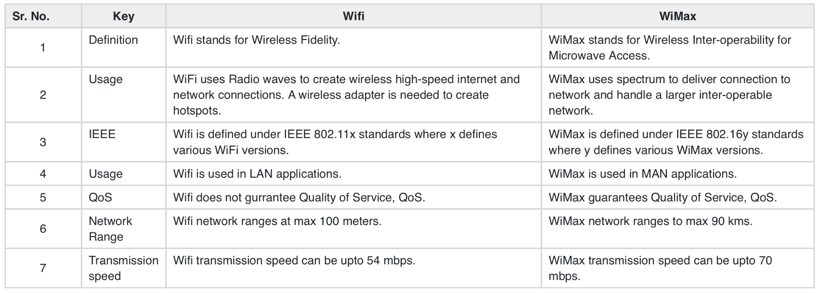
Comparison
WiMAX and Wi-Fi:

Slide 12
Comparison
WiMAX and Bluetooth:
These two protocols are wireless communication modules that can communicate with one another. The basic difference between them is that Bluetooth is used to make connections among the devices through the use of wireless while WiMax is used for microwave access.

Slide 13
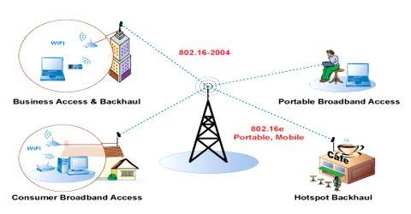
Areas of Usage

Slide 14
Areas of Usage
Providing portable mobile broadband connectivity across cities and countries through various devices.
Providing a wireless alternative to cable and digital subscriber line (DSL) for "last mile" broadband access.
Providing Internet connectivity as part of a business continuity plan.
Smart grids and metering.

Slide 15
Areas of Usage
Internet service in rural or underserved areas: WiMAX can be used to provide Internet access in areas where traditional broadband infrastructure is not available or is not cost-effective to deploy.
Wireless backhaul: WiMAX can be used to provide wireless connectivity between two or more locations, such as between a cell tower and a base station.

Slide 16
Areas of Usage
Mobile broadband: WIMAX can be used to provide high-speed Internet access to mobile devices, such as laptops, tablets, and smartphones.
Public Wi-Fi: WIMAX can be used to provide public Wi-Fi access in areas such as airports, hotels, and public parks.

Slide 17
Areas of Usage
Private networks: WIMAX can be used to create a private wireless network for businesses or organizations.
Emergency communications: WIMAX can be used to provide emergency communications in disaster situations where traditional communication infrastructure has been damaged or is unavailable.
Video surveillance: WIMAX can be used to transmit video from surveillance cameras to a central location in real-time.

Slide 18
Conclusion
WIMAX is currently being supported by the nonprofit WiMAX Forum, which has been formed to promote the adoption of WiMAX-compatible products and services while further developing it as a technological standard. As such, WiMAX is alive and well but is currently living in the shadow of Wi-Fi and modern cellular networks. Even so, it has been able to find its niche market and thrive as it delivers services that are ideal for last-mile, middle-mile, and even time-sensitive network services such as VoIP.

Slide 19
Thanks For Listening

